Slide 1
Quantum markov
25/9/2021

Slide 2
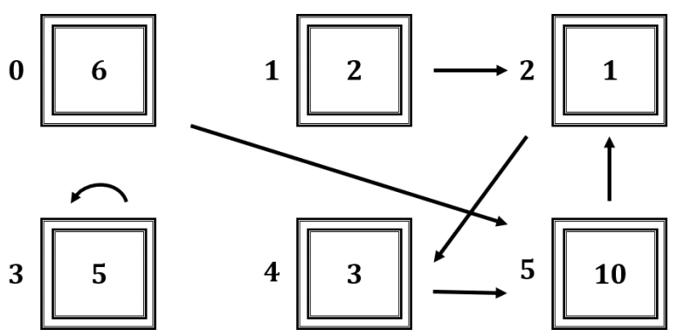
1. Classical (Many marbles)
Action / Operator $M=\left\lfloor \begin{matrix}\begin{matrix}0 & 0 & \begin{matrix}0 & 0 & \begin{matrix}0 & 0\end{matrix}\end{matrix}\end{matrix} \\ \begin{matrix}0 & 0 & \begin{matrix}0 & 0 & \begin{matrix}0 & 0\end{matrix}\end{matrix}\end{matrix} \\ \begin{matrix}\begin{matrix}0 & 1 & \begin{matrix}0 & 0 & \begin{matrix}0 & 1\end{matrix}\end{matrix}\end{matrix} \\ \begin{matrix}0 & 0 & \begin{matrix}0 & 1 & \begin{matrix}0 & 0\end{matrix}\end{matrix}\end{matrix} \\ \begin{matrix}\begin{matrix}0 & 0 & \begin{matrix}1 & 0 & \begin{matrix}0 & 0\end{matrix}\end{matrix}\end{matrix} \\ \begin{matrix}1 & 0 & \begin{matrix}0 & 0 & \begin{matrix}1 & 0\end{matrix}\end{matrix}\end{matrix}\end{matrix}\end{matrix}\end{matrix}\right\rfloor$
State $X_{t}={\text{[6, 2, 1, 5, 3, 10]}}^{T}$
State $X_{t+1}={MX_{t}\text{ = }\text{[}\text{0}\text{, }\text{0}\text{, 12, 5, }\text{1}\text{, }\text{9}\text{]}}^{T}$

Slide 3
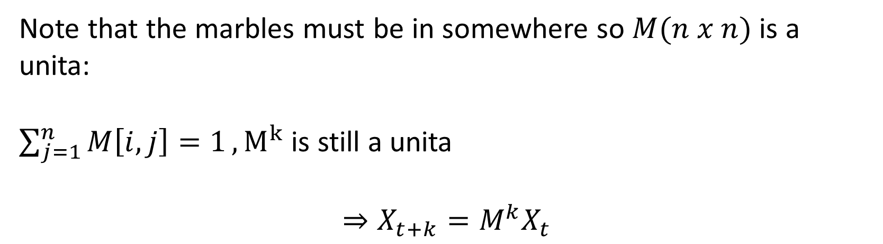
1. Classical
Note that the marbles must be in somewhere so $M(n x n)$ is a unita:
$\sum_{j=1}^{n}{M\left[i,j\right]=1}, M^{k}$ is still a unita
$$⇒X_{t+k}=M^{k}X_{t}$$

Slide 4
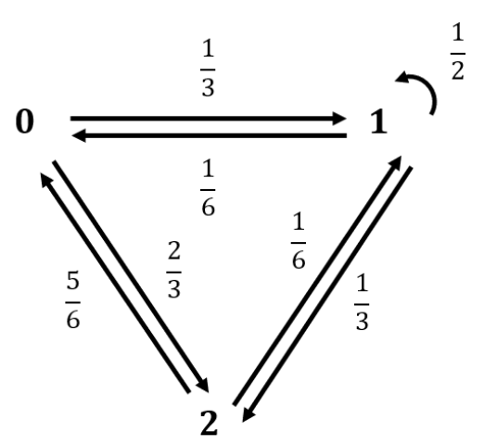

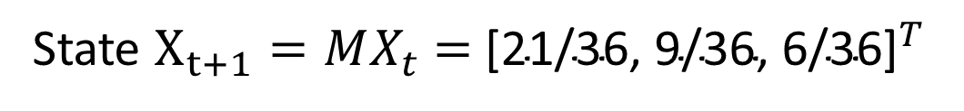
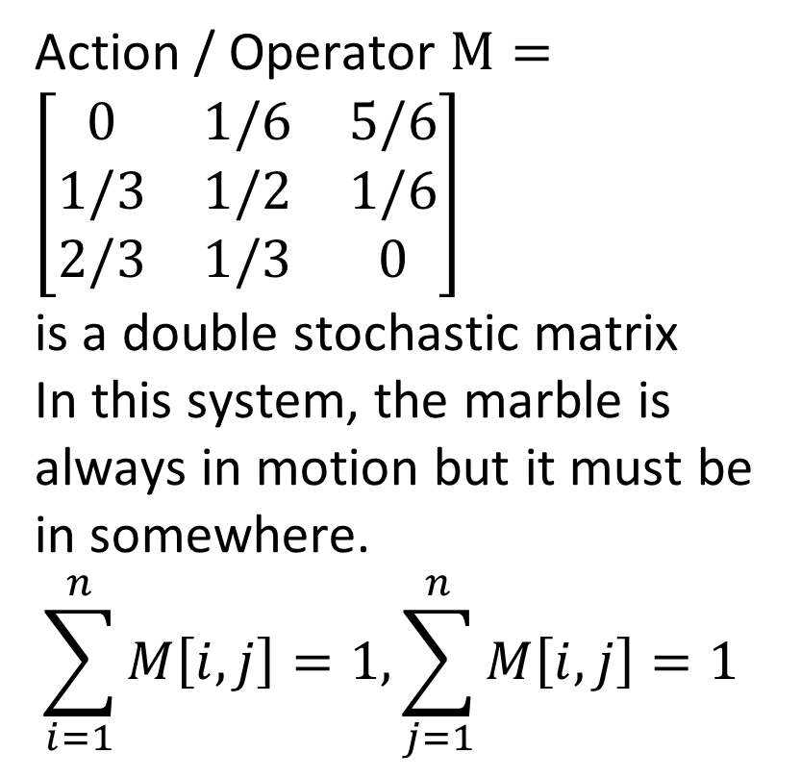
2. Dynamic / Markov (Single marble)
Action / Operator $M=\left[\begin{matrix}0 & 1/6 & 5/6 \\ 1/3 & 1/2 & 1/6 \\ 2/3 & 1/3 & 0\end{matrix}\right]$
is a double stochastic matrix
In this system, the marble is always in motion but it must be in somewhere.
$$\sum_{i=1}^{n}{M\left[i,j\right]=1,\sum_{j=1}^{n}{M\left[i,j\right]=1 }}$$
State $X_{t}={\text{[}\text{1/6, 1/6, 2/3}\text{]}}^{T}$
State $X_{t+1}={MX_{t}\text{ = }\text{[}\text{21/36}\text{, 9/36, 6/36}\text{]}}^{T}$

Slide 5
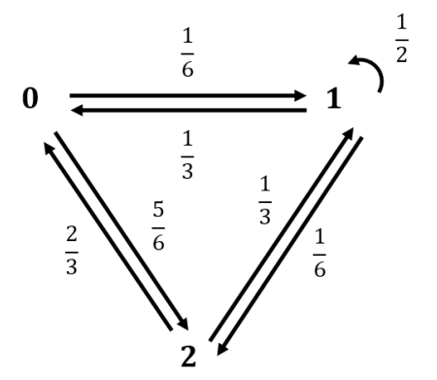

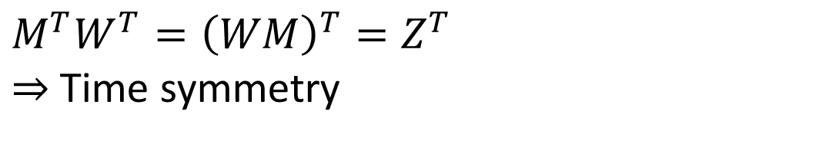

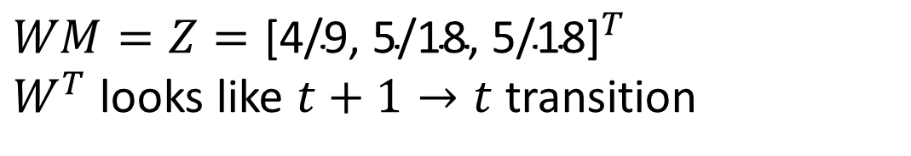
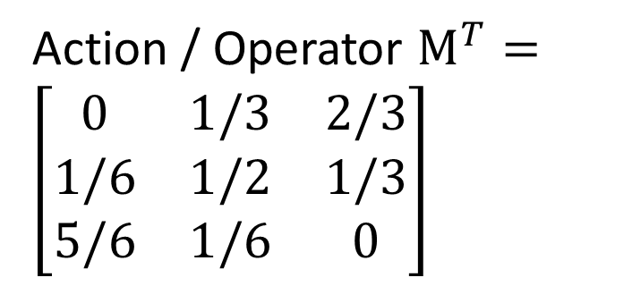
2. Markov
Action / Operator $M^{T}=\left[\begin{matrix}0 & 1/3 & 2/3 \\ 1/6 & 1/2 & 1/3 \\ 5/6 & 1/6 & 0\end{matrix}\right]$
State $W$ $={\text{[}\text{1/3, 0, 2/3}\text{]}}^{T}$
$$WM=Z={\text{[}\text{4/9, 5/18, 5/18}\text{]}}^{T}$$
$W^{T}$ looks like $t+1→t$ transition
$$M^{T}W^{T}={\left(WM\right)}^{T}=Z^{T}$$
$⇒$Time symmetry
$$M^{T}$$

Slide 6
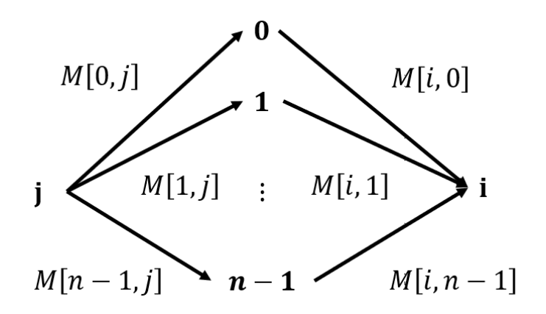
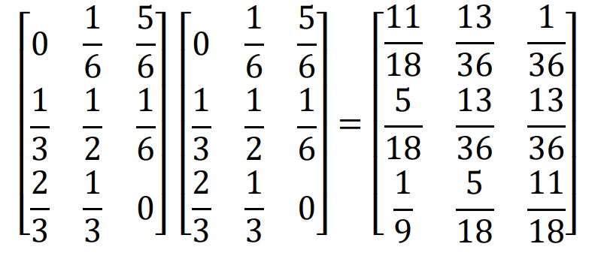
2. Dynamic
$$M∗M=M^{2}=$$
[0, 0]
[1, 0]
[1, 1]

Slide 7
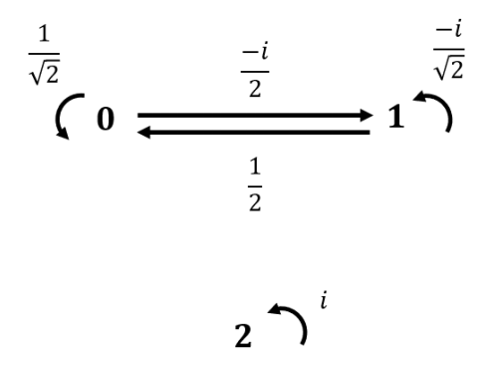


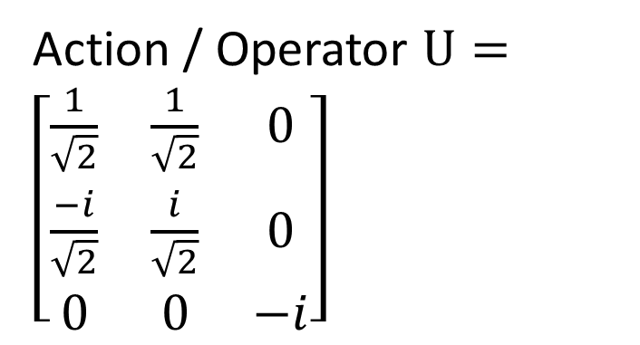
3. Quantum
Action / Operator $U=\left[\begin{matrix}\frac{1}{\sqrt{2}} & \frac{1}{\sqrt{2}} & 0 \\ \frac{−i}{\sqrt{2}} & \frac{i}{\sqrt{2}} & 0 \\ 0 & 0 & −i\end{matrix}\right]$
$U$is a unita matrix. Note that ${\left|U\right|}^{2}=\left[\begin{matrix}1/2 & 1/2 & 0 \\ 1/2 & 1/2 & 0 \\ 0 & 0 & 1\end{matrix}\right]$
State $X_{t}={\text{[}\frac{1}{\sqrt{3}}\text{, }\frac{2i}{\sqrt{15}}\text{, }\sqrt{\frac{2}{15}}\text{]}}^{T}$
State $X_{t+1}={MX_{t}\text{ = }\text{[}\frac{5+2i}{\sqrt{30}},\frac{−2−\sqrt{5}i}{\sqrt{30}}\text{,}\sqrt{\frac{2}{5}}i\text{]}}^{T}$

Slide 8
Quantum Turing machine

Slide 9
Time / space complexity
Consider Turing machine $M$
Reader
Tape
Notes:
Q x xichma x {L, R} is a function

Slide 10
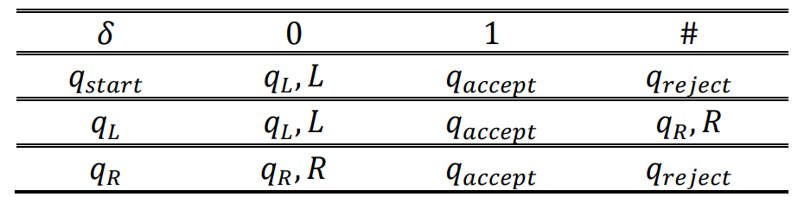


1. Deterministic
Deterministic Turing machine $M=\{Q,Σ,q_{start},q_{reject},q_{accept},δ\}$
$$Q=\{States\}$$
$$Σ=\left\{Alphabelt\right\}=\{0,1,\#\}$$
$δ=Q × Σ→Q × Σ × \{L, R\}$ (transition function)
Notes:
Q x xichma x {L, R} is a function

Slide 11
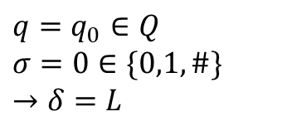
#
0
0
0
0
0
1
0
#
L
Reader
$$q=q_{0}∈Q$$
$$σ=0∈\{0,1,\#\}$$
$$→δ=L$$
R

Slide 12
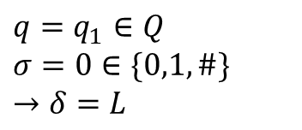
#
0
0
0
0
0
1
0
#
L
Reader
$$q=q_{1}∈Q$$
$$σ=0∈\{0,1,\#\}$$
$$→δ=L$$
R

Slide 13
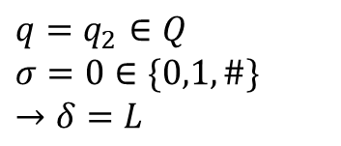
#
0
0
0
0
0
1
0
#
L
$$q=q_{2}∈Q$$
$$σ=0∈\{0,1,\#\}$$
$$→δ=L$$
Reader
R

Slide 14
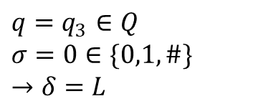
#
0
0
0
0
0
1
0
#
L
$$q=q_{3}∈Q$$
$$σ=0∈\{0,1,\#\}$$
$$→δ=L$$
Reader
R

Slide 15
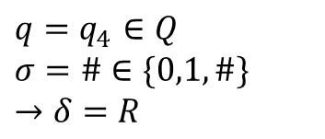
L
$$q=q_{4}∈Q$$
$$σ=\#∈\{0,1,\#\}$$
$$→δ=R$$
#
0
0
0
0
0
1
0
#
Reader
R

Slide 16
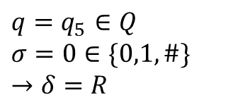
#
0
0
0
0
0
1
0
#
L
$$q=q_{5}∈Q$$
$$σ=0∈\{0,1,\#\}$$
$$→δ=R$$
Reader
R

Slide 17
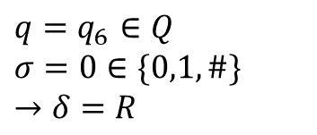
#
0
0
0
0
0
1
0
#
L
$$q=q_{6}∈Q$$
$$σ=0∈\{0,1,\#\}$$
$$→δ=R$$
Reader
R

Slide 18
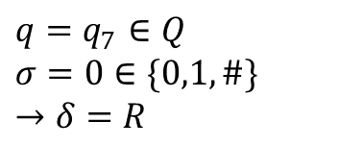
#
0
0
0
0
0
1
0
#
L
$$q=q_{7}∈Q$$
$$σ=0∈\{0,1,\#\}$$
$$→δ=R$$
Reader
R

Slide 19
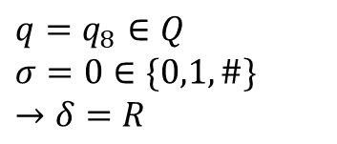
#
0
0
0
0
0
1
0
#
L
$$q=q_{8}∈Q$$
$$σ=0∈\{0,1,\#\}$$
$$→δ=R$$
Reader
R

Slide 20
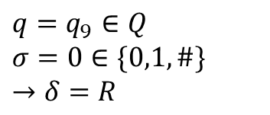
#
0
0
0
0
0
1
0
#
L
$$q=q_{9}∈Q$$
$$σ=0∈\{0,1,\#\}$$
$$→δ=R$$
Reader
R

Slide 21
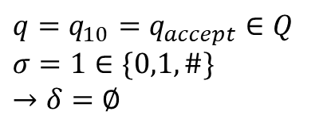
#
0
0
0
0
0
1
0
#
L
$$q=q_{10}=q_{accept}∈Q$$
$$σ=1∈\{0,1,\#\}$$
$$→δ=∅$$
Reader
R

Slide 22
2. Nondeterministic
Guessing module
Reader
Write - only head
Read – write head
# | 0 | 0 | 0 | 0 | 0 | 1 | #
Tape

Slide 23
2. Nondeterministic
Nondeterministic Turing machine $M=\{Q,Σ,q_{start},q_{reject},q_{accept},δ\}$
$δ=Q × Σ→𝒫(Q × Σ × \left\{L, R\right\})$, $𝒫(S)$ denotes for power set of $S$
If the problem is solvable in polynomial time by a non-deterministic Turing machine, the problem belongs to NP class

Slide 24





Deterministic
Nondeterministic
$$f(n)$$
$$q_{reject}$$
$$q_{accept}$$
…
…
$$q_{accept}/q_{reject}$$
$$q_{accept}$$
1 computation path
n computation path

Slide 25

Example: Sub-set sum probel
Given a set S = $\{1,−2, 5,3\}$. What sub-set of S has sum equal 7?

Slide 26











Deterministic
Nondeterministic
$$\{1\}$$
$$\{1\}$$
$$\{−2\}$$
$$\{5\}$$
$$\{3\}$$
$$\{−2\}$$
…
$$\{1,5,3\}$$
…
$$\{1,−2,5,3\}$$
$$q_{accept}$$
$$\{1,−2,5,3\}$$
$$q_{accept}$$
S = $\{1,−2, 5,3\}$.

Slide 27
Polynomial number of SPACE
PSPACE
Kiểm tra lời giải trong thời gian đa thức
Nonderterministic Turing machine in Polynomial number of step
NP
coNP
complement of NP
Cho một tập hợp các số nguyên, có phải tất cả tập hợp con đều có tổng khác T không?
Cho một tập hợp các số nguyên, tồn tại hay không một tập hợp con có tổng bằng T không?
P = coP
Polynomial number of step
Tồn tại lời giải trong thời gian đa thức
Notes:
Q x xichma x {L, R} is a function

Slide 28
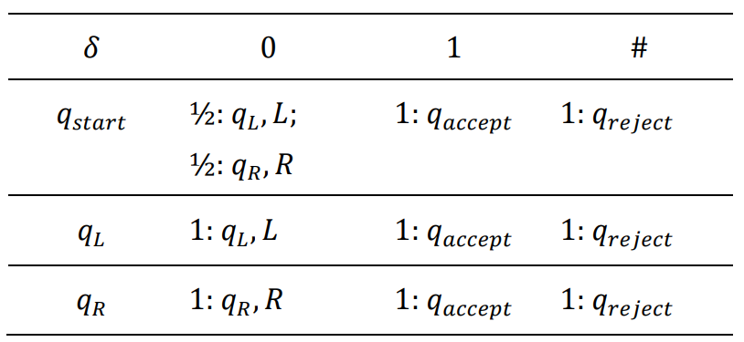
3. Probability
Nondeterministic Turing machine $M=\{Q,Σ,q_{start},q_{reject},q_{accept},δ\}$
$$δ=Q × Σ→{\left[0,1\right]}^{(Q × Σ × \left\{L, R\right\})}$$

Slide 29
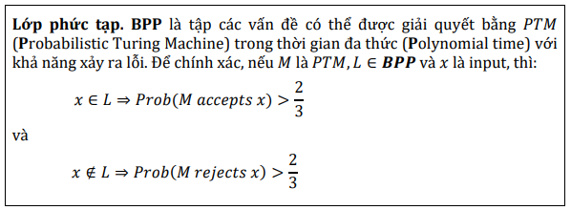
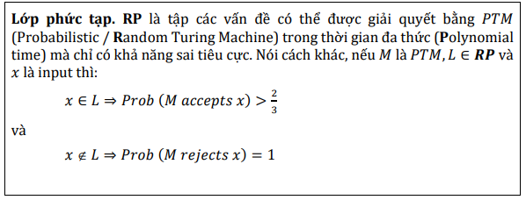









3. Probability
Lời giải đúng
Chấp nhận lời giải đúng
$$0.14$$
$$(q_{9},σ_{2},L)$$
$$0.23$$
$$(q_{17},σ_{18},R)$$
$$(q_{6},σ_{16})$$
$$(q_{17},σ_{18},R)$$
$$0.08$$
$$(q_{21},σ_{23},L)$$
$$0.55$$

Slide 30

3. Probability
Probabilistic Turing Machine in Polynomial time với khả năng xảy ra lỗi
BPP
Probabilistic / Random Turing Machine in Polynomial time with false negative only
Probabilistic / Random Turing Machine in Polynomial time with false positive only
RP
coRP
ZPP = RP $∩$ coRP
Probabilistic / Random Turing Machine in Polynomial time with Zero error

Slide 31
PSPACE
NP
BPP
coNP
RP
coRP
ZPP
P

Slide 32
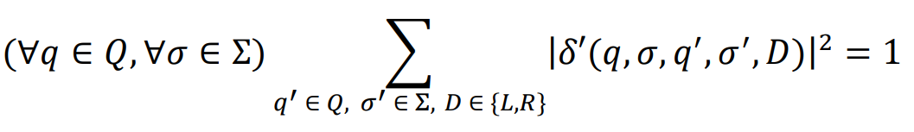
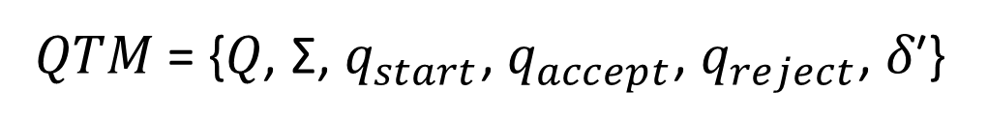

4. Quantum
Quantum Turing machine $M=\{Q,Σ,q_{start},q_{reject},q_{accept},δ\}$
𝑄𝑇𝑀 = {𝑄, Σ, $q_{start}$, $q_{accept}$, $q_{reject}$, 𝛿′}
𝛿′: 𝑄 × 𝛴 × 𝑄 × 𝛴 × {𝐿, 𝑅} → ℂ

Slide 33








$$c_{0}$$
$$\text{(}Trạng thái_{9}\text{)}$$
$$c_{1}$$
$$\text{(}Trạng thái_{16}\text{)}$$
($Trạng thái_{6}$)
$$…$$
$$c_{n−1}$$
$$\text{(}Trạng thái_{7}\text{)}$$

Slide 34
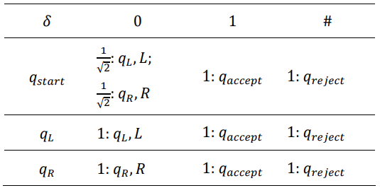
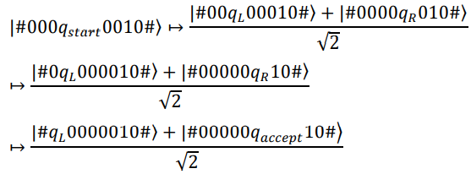
4. Quantum

Slide 35
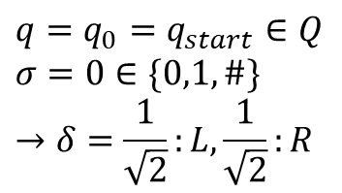
#
0
0
0
0
0
1
0
#
L
$$q=q_{0}=q_{start}∈Q$$
$$σ=0∈\{0,1,\#\}$$
$$→δ=\frac{1}{\sqrt{2}}:L,\frac{1}{\sqrt{2}}:R$$
Reader
R

Slide 36
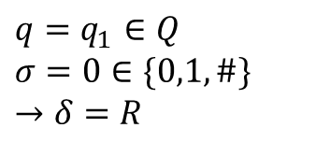
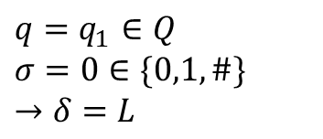
#
0
0
0
0
0
1
0
#
L
$$q=q_{1}∈Q$$
$$σ=0∈\{0,1,\#\}$$
$$→δ=L$$
Reader
$$q=q_{1}∈Q$$
$$σ=0∈\{0,1,\#\}$$
$$→δ=R$$
Reader
R

Slide 37
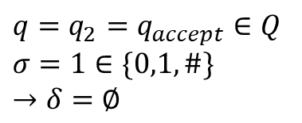
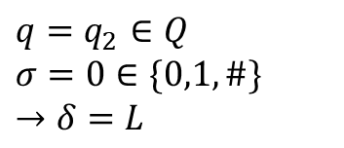
#
0
0
0
0
0
1
0
#
L
$$q=q_{2}∈Q$$
$$σ=0∈\{0,1,\#\}$$
$$→δ=L$$
Reader
$$q=q_{2}=q_{accept}∈Q$$
$$σ=1∈\{0,1,\#\}$$
$$→δ=∅$$
Reader
R

Slide 38
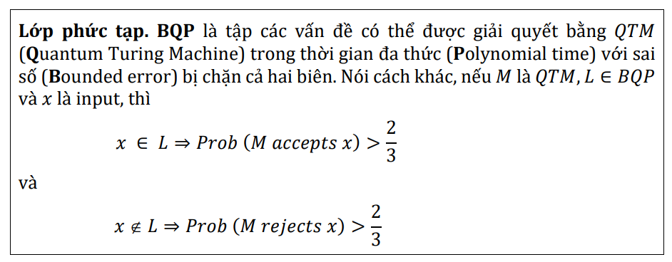
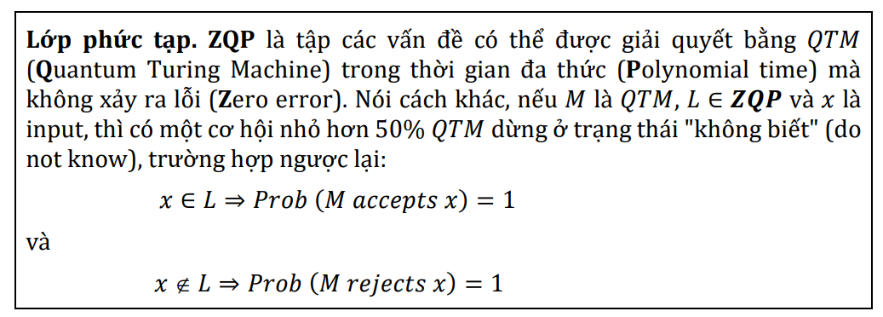
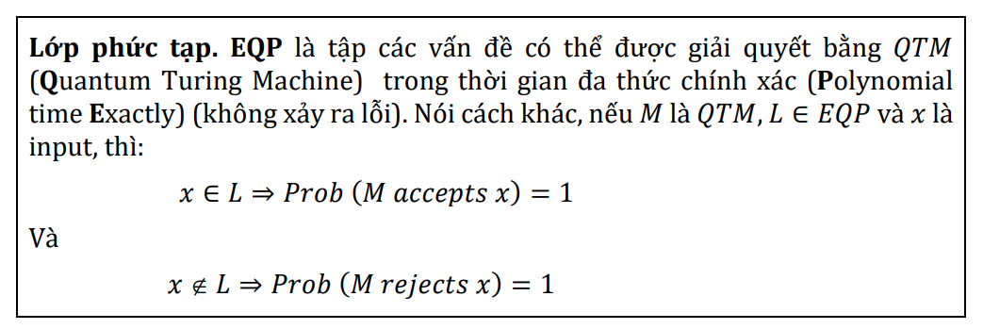
5. Quantum
𝑬𝑸𝑷 ⊆ 𝒁𝑸𝑷 ⊆ 𝑩𝑸𝑷
QP-algorithm for solving Simon’s problem

Slide 39
4. Quantum
PSPACE
BQP
NP
coNP
Quantum Turing Machine in Polynomial time with Bounded error (sai số bị chặn)
BPP
ZQP
Quantum Turing Machine in Polynomial time with Zero error
EQP
RP
coRP
Quantum Turing Machine in Polynomial Exactly time with no error
ZPP
P

Slide 40
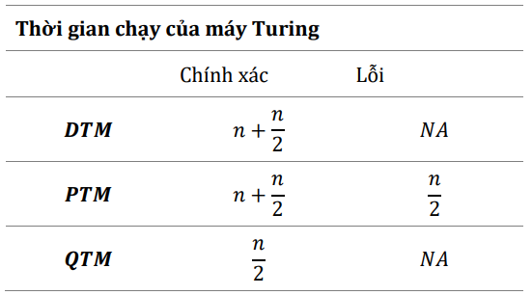
5. Summary

